Slide 1
Scholarships to Study & Intern Abroad
Program Overview, Eligibility, Application
The Benjamin A. Gilman International Scholarship Program is a program of the U.S. Department of State with funding provided by the U.S. Government and supported in its implementation by the Institute of International Education (IIE).
Notes:
The Benjamin A. Gilman Scholarship is a program of the U.S. Department of State with funding provided by the U.S. government and has been administered by the Institute of International Education (IIE) since the program’s inception in 2001.
The Gilman Scholarship Program has become the largest U.S. undergraduate scholarship program supporting U.S. students of high financial need to participate in study abroad programs and international internships.
Gilman is one of many vehicles to help students go abroad through scholarships; however it is much more than just a scholarship; it is now a program – it is the access to a life-changing experience, to an opportunity for students to give back to [their fellow students through follow on service projects students like you, and to become a part of a legacy that will continue to give them ongoing opportunities back to you.

Slide 2
U.S. Department of State
Promote mutual understanding between the people of the United States and the people of other countries, and they do so by facilitating opportunities of academic, professional, athletic, and other cultural exchange.
studyabroad.state.gov
exchanges.state.gov
The Benjamin A. Gilman International Scholarship Program is a program of the U.S. Department of State with funding provided by the U.S. Government and supported in its implementation by the Institute of International Education (IIE).
Notes:
The Gilman Scholarship is sponsored by the Bureau of Educational & Cultural Affairs, or ECA, in the U.S. Department of State.
ECA leads a wide range of academic, professional, and cultural exchanges with the goal of increasing mutual understanding and respect between the people of the United States and the people of other countries.
And the Gilman Scholarship is just one of the many programs sponsored by the ECA, and Gilman Scholars become a part of a network of approximately 40,000 people who participate in ECA programs every year.
Gilman is within the Office of U.S.A. Study Abroad, which is committed to shaping and sustaining a more peaceful, prosperous and just world by increasing and diversifying participation in study abroad. Please visit their websites for more information.

Slide 3
Gilman Program’s Impact
100% of Gilmans have financial need
Nearly 70% identify as racial or ethnic minority students
Nearly 60% come from small towns or rural communities within the United States
Nearly 50% are first-generation college students
38,000+ U.S. undergraduates of high financial need
160+ countries
1,300+ U.S. institutions represented
(Citation: The Gilman Program 20-year Impact Report)
Since Inception
The Benjamin A. Gilman International Scholarship Program is a program of the U.S. Department of State with funding provided by the U.S. Government and supported in its implementation by the Institute of International Education (IIE).
Notes:
By supporting U.S. undergraduate students with high financial need, the Gilman Program has been successful in supporting students who have historically been underrepresented in education abroad.
Since the program’s inception in 2001, more than 38,000 bright, ambitious, and diverse American students have received a Gilman Scholarship to study or intern in 160 countries and hail from more than 1,300 U.S. institutions.

Slide 4
Scholarships up to $5,000
Fall
Spring
Summer
Winter
Academic Year
The Benjamin A. Gilman International Scholarship Program is a program of the U.S. Department of State with funding provided by the U.S. Government and supported in its implementation by the Institute of International Education (IIE).
Notes:
For the entire academic year, we will award over 3,000 scholarships including awards for the Gilman-McCain Scholarship and awards associated with our global partnerships – the Gilman-Taiwan Scholarship, the Gilman- Germany DAAD Scholarship, the Gilman-FLAD Portugal Scholarship, the Gilman-Global Wales Scholarship, Gilman-Education New Zealand Scholarship, Gilman-Israel Scholarship, and Gilman-France Scholarship.
Recipients can receive up to $5,000 to use towards program costs and related expenses, such as tuition and fees, room and board, books, local transportation, health insurance, international airfare. passport and visa costs. (Personal expenses such as clothing, entertainment, electronics and excursions outside of the program are not eligible.)
Award amounts will vary depending on student need, strength of the application, and program cost.
Students can apply the scholarship toward a fall, spring, summer, winter, or academic year term program.
The Gilman Program is often asked by students, “what are the chances of me receiving a scholarship?” Generally 1 in 4 students are awarded a scholarship.
If selected for a Gilman Scholarship, recipients will utilize the password protected and secure Gilman Recipient Portal to input all fund distribution information. Recipients of the Gilman Scholarship will never be contacted by phone or email to provide personal bank information.

Slide 5
Critical Need Language Award
Up to an additional $3,000 + access to proficiency testing
Arabic
Azerbaijani
Bahasa Indonesian
Bangla
Chinese (Mandarin)
Hebrew*
Hindi
Japanese
Korean
Persian
Portuguese
Punjabi
Russian
Swahili
Turkish
Urdu
Studying any of these languages in sign language is also eligible for CNLA
Requires an additional essay to be considered
The Benjamin A. Gilman International Scholarship Program is a program of the U.S. Department of State with funding provided by the U.S. Government and supported in its implementation by the Institute of International Education (IIE).
Notes:
Applicants who are studying a critical need language in a country in which the language is predominantly spoken can apply for a supplemental award of up to $3,000 (for a combined total of up to $8,000). This Critical Need Language Award (CNLA)
[Slide has list of current critical languages, but please check website as “The number of eligible countries and languages supported by the CNLA are subject to change based on U.S. Department of State Travel Advisories and priorities.]
In addition to receiving additional funds for language study, students who win this award and complete their Gilman Scholarship requirements will be offered the opportunity to take the ACTFL Oral Proficiency Interview (OPI). This test and the results will serve as both an evaluation measure of the award and as a credential for the award recipient.
*****The CNLA for Hebrew language is offered through the generous support of our partners at the Embassy of Israel to the United States.

Slide 6
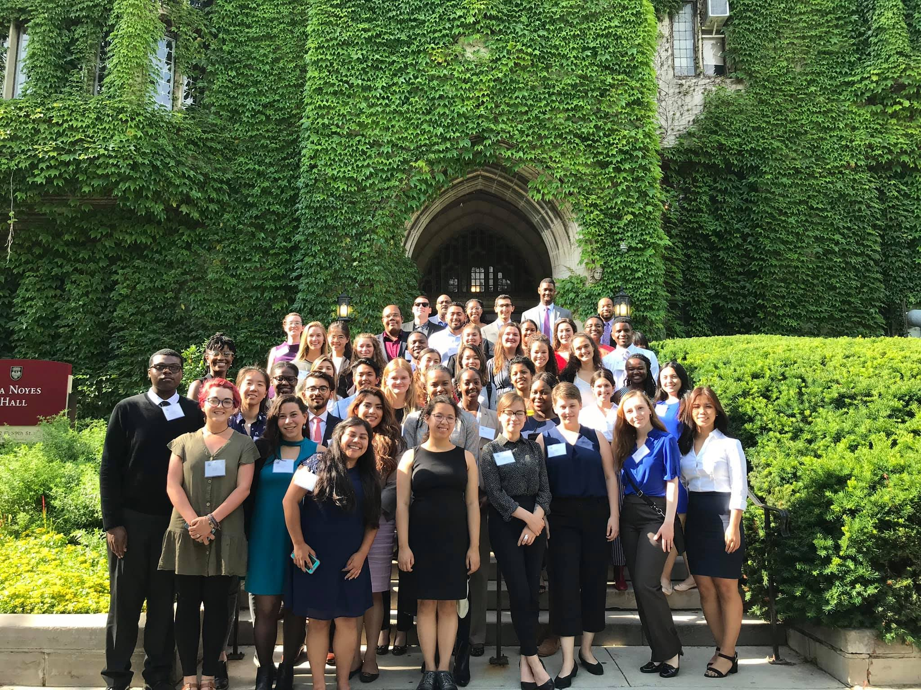
Gilman Alumni Benefits
Non-Competitive Eligibility (NCE)
Gilman Scholar Network
Alumni Ambassador Program
Seminars & Career Workshops
Networking Opportunities
Skill Development
The Benjamin A. Gilman International Scholarship Program is a program of the U.S. Department of State with funding provided by the U.S. Government and supported in its implementation by the Institute of International Education (IIE).
Notes:
When you become a Gilman Scholar and have completed your Follow-on Service Project within 6 months after you return home, you get to have access to many different benefits and opportunities.
Non-Competitive Eligibility (NCE)
Alumni of the Gilman program are eligible for 12 months of noncompetitive eligibility (NCE) hiring status with the federal government. It allows U.S. federal government agencies to hire eligible exchange program alumni outside the formal competitive job announcement process. Gilman alumni can also compete for certain federal employment jobs that are open only to federal employees. It’s a benefit that basically allows Gilman Alumni to jump to the front of the applicant line when applying for certain federal jobs. It doesn’t guarantee them a job but makes it much easier to be hired.
This 12-month period begins on the last day of the study or intern abroad program. Federal agencies may extend the period of eligibility for as many as two additional years, or a total duration of up to three years, if after your completed program, you:
Served in the military
Studied at a recognized institution of higher education*
Were involved in another activity that, in the agency’s view, warrants an extension.
*This means that alumni who return to their undergraduate studies after completing their Gilman Program are eligible for an extension in NCE status.
Gilman Scholar Network
The Gilman Scholar Network is the official site for Gilman Scholars and Alumni to connect with one another via a secure and private platform. The Gilman Scholar Network also gives Gilman Scholars and Alumni access to exclusive job postings and Gilman events.
Gilman Alumni Ambassador Program They serve for one year as official representatives of the U.S. Department of State’s Gilman International Scholarship Program. They provide testimonials about their Gilman Scholarship experiences at campus presentations and offer application tips via written articles, videos, webinars, and special events.
Seminars & Career Workshops
These events are available to all Gilman Scholars and Alumni to network and connect with other alumni. These workshops are also a great place to learn about the many career opportunities.
Skill Development
When you go abroad you learn new skills such as adapting to change, learning a new language, how to communicate with others, and much more.

Slide 7
Eligibility
The Benjamin A. Gilman International Scholarship Program is a program of the U.S. Department of State with funding provided by the U.S. Government and supported in its implementation by the Institute of International Education (IIE).

Slide 8
Gilman Eligibility
U.S. citizen or national
Undergraduate student
Federal Pell Grant recipient
Credit-bearing program
In a country or area with an overall Travel Advisory Level 1 or 2, or approved Level 3 exception location
No minimum length requirement!
The Benjamin A. Gilman International Scholarship Program is a program of the U.S. Department of State with funding provided by the U.S. Government and supported in its implementation by the Institute of International Education (IIE).
Notes:
To be eligible for a Gilman Scholarship, an applicant must be:
A US citizen or national
An undergraduate student in good standing
Receiving a Federal Pell Grant during the time of application or provide proof that they will be receiving a Pell Grant during the term of their study abroad program or internship;
Applying for credit-bearing study abroad programs in a country or area with an overall Travel Advisory Level 1 or 2, or approved Level 3 exception location. The Approved Level 3 Exception countries are updated weekly on the Gilman website: https://www.gilmanscholarship.org/applicants/gilman-updates-faqs/.
In the process of applying to, or accepted for, a study abroad or internship program eligible for credit from the student’s home institution. Multi-country/area programs are allowed. Proof of program acceptance is required prior to award disbursement
The Gilman Program no longer has a minimum program length requirement
Gilman Scholarship recipients can only receive the scholarship once. If a student previously declined the Gilman Scholarship, they are welcome to re-apply, as long as they still meet all eligibility requirements as listed above.

Slide 9
Gilman Eligibility
Recipients may be permitted to travel abroad as a Gilman Scholar if their program’s country/area(s) meet the following criteria:
Travel Advisory Levels 1 or 2, according to the U.S. Department of State’s Travel Advisory System, or
On the list of approved Travel Advisory Level 3 countries/areas
The Benjamin A. Gilman International Scholarship Program is a program of the U.S. Department of State with funding provided by the U.S. Government and supported in its implementation by the Institute of International Education (IIE).
Notes:
The U.S. Department of State continues to update Travel Advisories, and the State Department’s Bureau of Educational and Cultural Affairs (ECA) continues to closely monitor the status of COVID-19 globally. As a result of close consultation between ECA and U.S. Embassies and Consulates, the Gilman Program has temporarily updated travel policies to allow Gilman Scholars to study/intern in select locations with a Level 3 Travel Advisory.
Per long-standing policy, Gilman Scholars are permitted to study or intern only in locations with a Level 1 or 2 Travel Advisory. For programs starting on or after January 1, 2022, Gilman Scholars will be able to participate in programs in a select number of locations with Level 3 Travel Advisories. The program location must be a Level 1 or 2, or an approved Level 3 Travel Advisory exception location, at the start of the program.

Slide 10
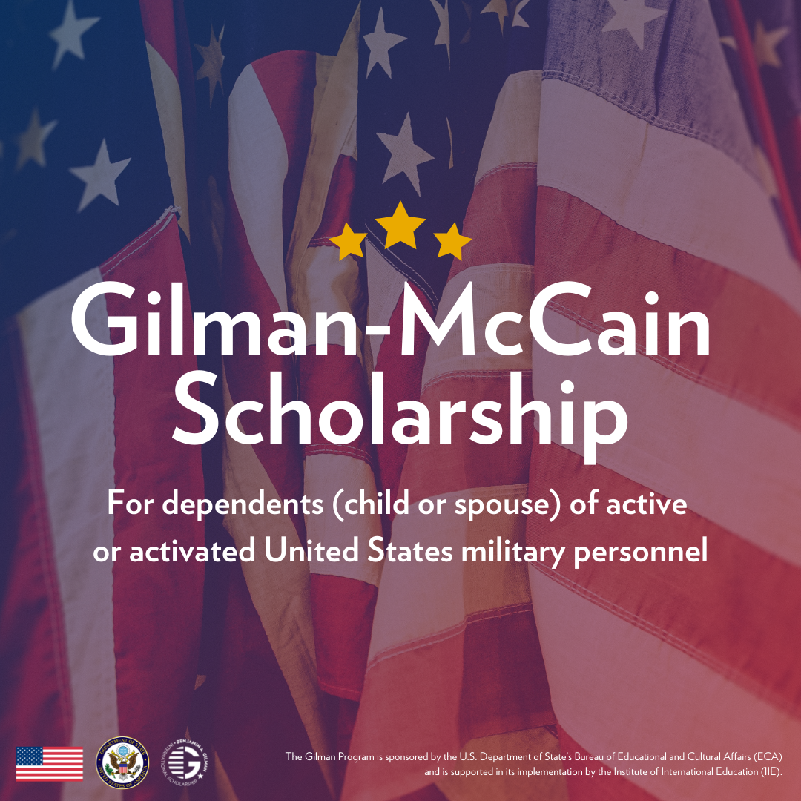
Gilman-McCain Scholarship Eligibility
$5,000 for child or spousal dependents of active-duty service members
U.S. citizen
Undergraduate student
Credit-bearing program
In a Travel Advisory level 1 or 2 country, or level 3 approved exception
No minimum length requirement!
Recipient of any type of Title IV federal financial aid
Dependent (child or spouse) of active or activated United States military personnel during the time of application (including Air Force, Air Force Reserve, Air National Guard, Army, Army National Guard, Army Reserve, Coast Guard, Coast Guard Reserve, Marine Corps, Marine Corps Reserve, Navy, Navy Reserve, Space Force, NOAA Commissioned Corps, and USPHS Commissioned Corps)
The Benjamin A. Gilman International Scholarship Program is a program of the U.S. Department of State with funding provided by the U.S. Government and supported in its implementation by the Institute of International Education (IIE).
Notes:
The U.S. Department of State’s Gilman-McCain Scholarship provides awards of $5,000 for dependents (child or spouse) of active or activated United States military personnel during the time of application to study or intern abroad on credit-bearing programs. Developed under the framework of the State Department’s Benjamin A. Gilman International Scholarship Program, the John McCain International Scholarship for Military Families (Gilman-McCain Scholarship) is open to eligible students enrolled at accredited U.S. colleges and universities who receive any type of Title IV federal financial aid.
To apply, you will use the online Gilman-McCain application and you will be required to upload a copy of your military dependent ID to submit the application.
Besides being a dependent (child or spouse) of active or activated United States military personnel during the time of application and having any type of Title IV federal financial aid, all other eligibility requirements are the same as the Gilman Scholarship.
For more information, please visit the Gilman-McCain Scholarship web page. https://www.gilmanscholarship.org/program/gilman-mccain-scholarships/

Slide 11
Application
The Benjamin A. Gilman International Scholarship Program is a program of the U.S. Department of State with funding provided by the U.S. Government and supported in its implementation by the Institute of International Education (IIE).

Slide 12
2 Steps
Student Application
Advisor Certifications
Abroad Program Info
Essays
Unofficial Transcript(s)
Select Advisors
Study Abroad Advisor
Financial Aid Advisor
The Benjamin A. Gilman International Scholarship Program is a program of the U.S. Department of State with funding provided by the U.S. Government and supported in its implementation by the Institute of International Education (IIE).
Notes:
The entire application process is conducted online and has two steps.
Step 1: The online application asks for study abroad/internship program details, three essays (or additional 4th essay if you’re applying for the CNLA), and an undergraduate transcript. The Gilman Program requires transcripts for applicants’ current institution and transcripts from any previous institutions attended. ​These transcripts can be official or unofficial. I’ll talk about the essays in the next slides.
The application also requires applicants to select a study abroad advisor and a financial aid advisor within the application.
Step 2: Once the student has submitted the application, it must be certified by both a study abroad and financial aid advisor. The deadline the advisor certifications is one week after the students’ deadline.

Slide 13
Essay #1
Required
Max. 7000 characters
Statement of Purpose
You + Program + Goals
Personal Interview
Meeting Challenges
(academic, professional, personal)
The Benjamin A. Gilman International Scholarship Program is a program of the U.S. Department of State with funding provided by the U.S. Government and supported in its implementation by the Institute of International Education (IIE).
Notes:
In your application, you must submit three essays (four if you are applying for CNLA).
The Statement of Purpose has a maximum of 7,000 characters, which is roughly about a page and a half. The essays are important because Selection Panelists, advisors and administrators at U.S. campuses, review these applications and this is their only way of getting to know who you are and reasons for studying abroad. In the application, the Gilman Program provides prompts for each essay – questions that you should consider answering in your essays.​
​
The Statement of Purpose essay is essentially a personal interview on paper. You should talk about the impact of study abroad on your academic goals, professional goals and personal growth, as well as how the Gilman Scholarship can help you accomplish these goals. You should also touch upon what inspired you to study abroad and what challenges you have faced in studying abroad, so they can discern the knowledge, skills, and experiences that can be drawn on to meet challenges experienced abroad.
All students applying to the Gilman Program have financial need, so you may speak of this, but elaborate on other challenges you may face in addition to that.
There is a preference for distributing Gilman awards to students from community colleges, student who are first-generation college students, students with disabilities, and students who identify as a student of racial or ethnic minority. Be sure to incorporate your status as a community college student into your essay. And if any of these other preferred criteria apply to you, be sure to include details about your experiences in these regards as well.

Slide 14
5 Questions to Ask Yourself
Statement of Purpose Essay
1. Do you make a connection between your program and goals?
2. Do you make a connection between your country and goals?
3. Do you share how you will be academically successful on your program?
4. Do you give examples of your experiences, skills, and knowledge that you will use to meet program challenges?
5. Do you address how this abroad experience will impact your future?
The Benjamin A. Gilman International Scholarship Program is a program of the U.S. Department of State with funding provided by the U.S. Government and supported in its implementation by the Institute of International Education (IIE).
Notes:
Here are some questions to reflect on while writing your statement of purpose.
Do you make a connection between your program and goals?
Do you make a connection between your country and goals?
Do you share how you will be academically successful on your program?
Do you give examples of your experiences, skills, and knowledge that you will use to meet program challenges?
Do you address how this abroad experience will impact your future?
These questions will help you stay organized and on task. You can begin by using these questions to start brainstorming and drafting your essay.

Slide 15
Essay #2
Required
Max. 3000 characters
Community Impact:
Building Mutual Understanding Essay
What it means to be a U.S. citizen while abroad
How you will seek opportunities to be culturally engaged
Seeking opportunities to have meaningful interactions
The Benjamin A. Gilman International Scholarship Program is a program of the U.S. Department of State with funding provided by the U.S. Government and supported in its implementation by the Institute of International Education (IIE).
Notes:
There are two community impact essays that are both required and are equally important. We strongly encourage you to read the Selection Criterion Community Impact Abroad & Student’s Return Home.
The Community Impact: Building Mutual Understanding Essay requires you to answer how you will be a U.S. citizen diplomat as a Gilman Scholar while abroad
​
Key aspects to this essay are how you will be a U.S. representative abroad and how you will seek opportunities to become more culturally engaged and have meaningful interactions with people from different cultures on your abroad program. It might help to connect with previous study abroad experiences to learn about their experiences abroad – previous Gilman recipients would be especially useful sources of insight.
This essay has a maximum of 3,000 characters.

Slide 16
3 Questions to Ask Yourself
Building Mutual Understanding Essay
1. Do you articulate how you will represent the U.S. as a citizen diplomat while abroad?
2. Do you explain how you will contribute to the goal of building mutual understanding?
3. Do you discuss how you will look for opportunities to build meaningful relationships and become more culturally engaged?
The Benjamin A. Gilman International Scholarship Program is a program of the U.S. Department of State with funding provided by the U.S. Government and supported in its implementation by the Institute of International Education (IIE).
Notes:
Here are some questions to reflect on while you write the essay on building mutual understanding:
Do you articulate how you will represent the U.S. as a citizen diplomat while abroad?
Do you explain how will contribute to the goal of building mutual understanding?
Do you discuss how you will look for opportunities to build meaningful relationships and become more culturally engaged?

Slide 17
Essay #3
Required
Max. 3000 characters
Community Impact:
Follow-on Service Project Proposal
How will you give back by inspiring others to study abroad?
Being an effective citizen diplomat while abroad
On campus or in home community
Design plan of action
(audience, tools, timeline)
The Benjamin A. Gilman International Scholarship Program is a program of the U.S. Department of State with funding provided by the U.S. Government and supported in its implementation by the Institute of International Education (IIE).
Notes:
The Gilman Program and the program’s sponsors at the U.S. Department of State value the multiplier effect that this program has on U.S. campuses and communities.
Therefore, the Follow-On Service Project Proposal requires you to answer how you will represent the Gilman Program upon your return home by requiring you to design a project to promote the Gilman Scholarship Program. In this essay, students are asked to map out a potential project for them to complete upon their return to the U.S. that will encourage others to study or intern abroad and spread awareness of the Gilman Scholarship Program.
The project can be completed on their home campus or in their local community and must be completed within 6 months of their return to the U.S. Key aspects of this essay include how you will be an effective U.S. representative at home and the creativity and feasibility of your Follow On Service Project.
The Gilman Program advises students to use activities and organizations that they are already involved in as an inspiration and can therefore begin discussion of their project with key contacts even prior to being awarded the scholarship.
We also ask that students consider their audience, tools, and timeline when proposing a project in the Gilman Scholarship Program application.
This essay has a maximum of 3,000 characters.

Slide 18
5 Questions to Ask Yourself
Follow-On Service Project Proposal
1. Does your FOSP increase awareness of the Gilman Scholarship and study abroad?
2. Is your project feasible?
3. Do you give a detailed plan for your project?
4. Do you incorporate your study abroad experience into you project?
5. Do you have an intended audience? Who will you collaborate with to reach this community?
The Benjamin A. Gilman International Scholarship Program is a program of the U.S. Department of State with funding provided by the U.S. Government and supported in its implementation by the Institute of International Education (IIE).
Notes:
Here are some questions to reflect on while writing your Follow-on Service Project Proposal:
Does your FOSP increase awareness of the Gilman Scholarship and study abroad?
Is your project feasible?
Do you give a detailed plan for your project?
Do you include your study abroad experience into you project?
Do you have an intended audience? Who will you collaborate with to reach this community?
Your Study Abroad advisor is a great resource for planning your Follow-On Service Project, so connect with them if you need some support.

Slide 19
Essay #4
Optional
Max. 2000 characters
Critical Need Language Award Essay
Is it predominantly spoken in the country you’re going to?
Motivations for improving language proficiency (academic, professional, personal)
How does it relate to your academic or career goals?
Is it a critical need language?
The Benjamin A. Gilman International Scholarship Program is a program of the U.S. Department of State with funding provided by the U.S. Government and supported in its implementation by the Institute of International Education (IIE).
Notes:
As explained earlier, applicants who are studying a critical need language while abroad in a country in which the language is predominantly spoken have the option to be considered for the Critical Need Language Award, for a supplemental award of up of $3,000. This award is competitive and offered to a limited number of students each year. To be considered for the Critical Need Language Award, a brief additional essay is required and can be submitted in the same Gilman application.
Some key points to keep in mind are:​
Be sure that the language you are studying while abroad is considered a Critical Need Language by the U.S. Department of State. You can see the list of Critical Need Languages at gilmanscholarship.org. Any other language study is not eligible for the Critical Need Language Award.​
Be sure that you are studying the Critical Need Language in a country where it is predominately spoken. ​
Explain the level of intensity of your critical need language study while abroad, how studying this language will further your academic and career goals, what your motivations are for learning or improving your language proficiency, and how you intend to improve your language skills while studying abroad.
This essay has a maximum of 2,000 characters.

Slide 20
Selection Criteria
Impact of Program & Destination on Student’s Academic & Career Directory
Community Impact Abroad &
Upon Student’s Return Home
Academic Preparedness
Diversity of Background & Experience
Commitment to Proficiency in a
Critical Need Language
The Benjamin A. Gilman International Scholarship Program is a program of the U.S. Department of State with funding provided by the U.S. Government and supported in its implementation by the Institute of International Education (IIE).
Notes:
Impact of program & destination on student’s academic & career trajectory:
A successful applicant will demonstrate a coherent link between their proposed program abroad activities and their future academic and/or career plans, as well as personal development goals. Students should detail the different aspects of their program and articulate how their participation and receipt of the Gilman Scholarship would support the achievement of their goals.
Community Impact Abroad & Upon Student’s Return Home
The mission of the U.S. Department of State’s Bureau of Educational and Cultural Affairs’ is to increase mutual understanding between the people of the United States and the people of other countries by means of educational and cultural exchange. The Gilman Program plays an essential role in achieving this mission, because study abroad IS a form of diplomacy. Gilman Scholars represent the United States as citizen diplomats in their host communities; they reflect a diversity of values, beliefs, and opinions that is fundamental to providing a balanced representation of the United States abroad. Gilman Scholars are expected to contribute to the goal of building mutual understanding by sharing what it means to be an American, learning about the host culture, and building meaningful relationships.
Upon return to the United States, Gilman Scholars have the opportunity to inspire the next wave of students to study or intern abroad through the required Follow-on Service Project. The goal of the Follow-on Service Project is for Gilman Scholars to increase awareness of study abroad and the Gilman Scholarship among their peers in their home communities and campuses. A successful Follow-on Service Project proposal will be feasible, utilize one’s experience abroad, and connect to diverse groups of Americans.
Academic Preparedness (Updated)
The U.S. Department of State is committed to ensuring that Gilman Scholars are successful on their programs abroad. A competitive applicant must demonstrate the academic preparedness needed to gain benefit from a study abroad or international internship program. They should disclose any significant challenges they have faced in their academic career and discuss how they will be academically successful on their abroad program. Academic performance, particularly in the applicant’s major, is important, though there is no minimum grade point average for participating in the Gilman Program.
Diversity of Background & Experience (Updated)
The U.S. Department of State’s Gilman Program seeks participation by the broadest group of American undergraduate students with financial need who will benefit from the knowledge, skills, and experiences they acquire when studying abroad. By supporting students who have high financial need, the program has been successful in supporting students who have been historically underrepresented* in education abroad. Students’ knowledge, skills, and personal experiences are considered in the context of the overall impact the proposed abroad program will have on them, how they will overcome any anticipated challenges during the program, and their ability to be a representative of the United States and the Gilman Program.
Note: Preference should be given to those who have not studied abroad before and to Veterans who served on active duty in the U.S. Armed Forces (Army, Marine Corps, Navy, Air Force, or Coast Guard), provided their qualifications are approximately equivalent to those of other candidates.
*Including but not limited to, first-generation college students, students in STEM fields, racial and ethnic minority students, students with disabilities, students attending minority-serving institutions and community colleges, and students from U.S. states and institutions with lower study abroad participation, and more.
Additional Review Criteria For Students Applying for the Critical Need Language Award:
The supplemental essay completed by students applying for the Critical Need Language Award will be considered using the following additional criteria: The U.S. Department of State is dedicated to supporting students who are studying a critical need language (those deemed important to national security). Applicants are considered for this category if while abroad they are taking a course taught in a critical need language, studying a critical need language, or both, in a country or area that predominantly speaks the language. A successful applicant should demonstrate a strong motivation to achieve proficiency in the language that extends beyond their study abroad experience, and into their future academic and career goals.

Slide 21
Deadlines and Timelines
The Benjamin A. Gilman International Scholarship Program is a program of the U.S. Department of State with funding provided by the U.S. Government and supported in its implementation by the Institute of International Education (IIE).

Slide 22
Deadlines & Timelines
Application Opens
Applicant Deadline
Advisor Deadline
October 2023 Deadline
October 5, 2023
11:59pm PT
Mid-August
October 12, 2023
Abroad Program Starts
Dec 2023 – Oct 2024
March 2024 Deadline
March 7, 2024
11:59pm PT
Mid-January
March 14, 2024
Abroad Program Starts
May 2024 – April 2025
The Benjamin A. Gilman International Scholarship Program is a program of the U.S. Department of State with funding provided by the U.S. Government and supported in its implementation by the Institute of International Education (IIE).
Notes:
There are two deadlines to keep in mind: the applicant deadline (which is the deadline for students to have submitted their application) and the advisor deadline (which is the deadline for both advisors to have completed their certifications of the student’s application).
The October 2023 Deadline cycle may encompass programs beginning December 2023 – October 2024. This application opens in mid-August and the student deadline is Thursday October 5th, 2023, at 11:59pm Pacific Time. The Advisor certification deadline is October 12th. Advisors cannot certify your application until you have submitted your application by the 5th
Please note again that the deadlines are at 11:59pm Pacific Time.

Slide 23
Application Tips
The Benjamin A. Gilman International Scholarship Program is a program of the U.S. Department of State with funding provided by the U.S. Government and supported in its implementation by the Institute of International Education (IIE).

Slide 24
Tips for Getting Started on your Essays

Slide 25
The Process
⏳
💭
📄
🚧
🔎
Gather materials/plan logistics
Brainstorm your response to each essay prompt
Use the “Questions to Ask Yourself”
Research
Seek advice
Outline
Build (detail, context, etc.)
Review & revise
Notes:
So, you’ve decided you want to study or intern abroad, you’ve determined you’re eligible for the Gilman Scholarship, but you know that it’s competitive. You might wonder what makes a strong application? –
The best tip is to begin planning early. You will need to coordinate a lot of information related to your program abroad, your academics at home, your financial and logistical resources, as well as spend time working on your essays and actually completing the application. You also have to get a hold of your transcript, which often takes a few days.
A survey of previous applicants indicated that it takes an average of five to ten hours to complete the Gilman Scholarship application, so if you begin planning early you will be sure to have a quality application in way before the last minute.
For all your essays, make sure that you fully answer the prompts, and that you invest time in writing drafts, editing, and having others proofread your essays. You wouldn’t believe how many students we have every year that write “study aboard” instead of “study abroad.” The extra steps to proofread and make corrections ensures that your essays are easy to read and the reviewers are able to get to know you.
Before you submit your application, you have the opportunity to review your application before you finally submit it. Take the time to check for accuracy regarding all information you’ve inputted. Putting the wrong information may cause your application to not meet eligibility requirements and therefore put you out of scholarship consideration.

Slide 26
Gilman Scholars’ Tips for Applicants
Create a compelling story that ties your past, present, and future to highlight the impact the scholarship will have on you.
Start the application early, be your truest self, and have confidence that you are worthy.
The Benjamin A. Gilman International Scholarship Program is a program of the U.S. Department of State with funding provided by the U.S. Government and supported in its implementation by the Institute of International Education (IIE).
Notes:
Spend quality time on your essays. Your essays are the portion of your Gilman Application that you will be able to use to fully present yourself to the Selection Panel. Because you will not meet them in person, and because the Review panel does not make any assumptions about an applicant, you must use your essays as a chance to let the panelists get to know you.
It’s important to take the opportunity in your essay to really demonstrate who you are and why you want to study/intern abroad, get across your passion and interests. A student who says they just want to go somewhere is not as compelling as a student who talks about the impact of their proposed program.

Slide 27
Gilman Scholars’ Tips for Applicants
Remember you’re telling your story to someone who has never met you before.
Visiting the Writing Center or getting feedback from other peers can help you identify where more context is needed.
The Benjamin A. Gilman International Scholarship Program is a program of the U.S. Department of State with funding provided by the U.S. Government and supported in its implementation by the Institute of International Education (IIE).
Notes:
A best practice for applying for scholarships is having your essay drafts read by trusted peers and writing tutors. Sharing your drafts with others for feedback helps you identify areas that could use more detail or revision.

Slide 28
Gilman Scholars’ Tips for Applicants
For your Follow-on Service Project, think about your community and local schools. Think of how you heard about Gilman and how you could tell others about it!
If you don’t apply, you’ll never get it!
The Benjamin A. Gilman International Scholarship Program is a program of the U.S. Department of State with funding provided by the U.S. Government and supported in its implementation by the Institute of International Education (IIE).
Notes:
Remember that your Follow-on Service Project will require some planning. Don’t fret! You have resources to help you.
Consider how you learned about the Gilman scholarship – maybe this will help you brainstorm ideas for your own project. You can also get help from your Study Abroad advisor and find examples of past recipients’ service projects on social media.

Slide 29
Make it Easier
Give yourself plenty of time to write
Break up the writing task
Step 1: Brainstorm
Step 2: Organize ideas (outlining)
Step 3: Draft
Step 4: Revise
Seek advice from the Study Abroad Analyst (studyabroad@mesacc.edu)
Visit the Writing Center
Celebrate your efforts
Notes:
Getting started can be the hardest part, and it will help to break the project up into more manageable tasks. Start with gathering the information you need and brainstorming. Then start putting your ideas together in an organized fashion and start building your essays. Then you’ll move on to revision (and remember to seek assistance from others!).
Along the way, celebrate the progress you’ve made and how close you are to the finish line. Take breaks as needed and do things to help you stay motivated – if snacks and walks are you thing, work this into your routine to help you recharge!
This process works best when you start as early as possible, not waiting until the last minute to complete and submit! Every cycle we have students who have questions the night of the application deadline. Please know that we are not available at 10pm to answer last minute questions so make sure you take care of any issues before that time.

Slide 30
Easier Each Time
Keep all of your scholarship essays.
Use previous essays to inform/inspire future essays.
Remember to tailor each scholarship essay to the prompt/donor.
The process gets easier each time you go through it!
Notes:
It might help to remember that applying for scholarships like the Gilman scholarship gets easier every time you do it. As you work through the Gilman scholarship, you can set yourself up for even more success in the future. Keep all of your scholarship essays and accompanying notes. You can use materials from previous scholarship applications to inform future scholarship applications – you might even keep a document that lists the names of all the student clubs/extracurriculars you’ve been part of along with the dates you participated and any positions you held.
Just remember to tailor each application to the specific scholarship you’re applying for; you don’t want to use the same exact essay for every scholarship.
Each time you go through the process, it gets easier. The more you apply, the better you get at applying and the better your chances at getting scholarship money!

Slide 31
Writing Center
Southern & Dobson (LB-175) / Virtual
Hours of Operation
Monday - Thursday: 9am - 7pm
Friday: 9am - 3pm
Red Mountain (Desert Willow - 1st floor)
Hours of Operation
Wednesday: 9am - 6pm
Notes:
Remember, in addition to your Study Abroad advisor, the Writing Center is here to help you! Walk in during our hours of operation, virtually or in person. We can help you at any stage of the writing process, whether you’re still brainstorming or getting ready to hit “submit.” We’re a completely free resource, so take advantage of our services!

Slide 32
Stay Connected
Facebook
Instagram
Twitter
YouTube
#GilmanScholarship
The Benjamin A. Gilman International Scholarship Program is a program of the U.S. Department of State with funding provided by the U.S. Government and supported in its implementation by the Institute of International Education (IIE).
Notes:
There are lots of ways to stay connected to the Gilman Program for program updates and information. The Gilman YouTube channel has videos from previous recipients, as well as instructional videos on things such as uploading transcripts and navigating the application site.
You can also check out the Gilman Global Experience Blog, which is written by Gilman scholars while they are abroad, allowing you to see what it’s like to study abroad.
Or simply search #gilmanscholarship to see more!

Slide 33
Resources for International Exchange
Other U.S. Government Resources:
Critical Language Scholarship Program
Fulbright U.S. Student Program
Boren Scholarships and Fellowships
studyabroad.state.gov
The Benjamin A. Gilman International Scholarship Program is a program of the U.S. Department of State with funding provided by the U.S. Government and supported in its implementation by the Institute of International Education (IIE).
Notes:
There are also many other resources available to you as you search for study or internship abroad scholarships.
There are resources available on the Gilman website as well as www.studyabroad.state.gov, which is an online searchable database of various study abroad scholarships. The USA Study Abroad Office website also has resources for additional opportunities including the Critical Language Scholarship, the Boren Award for International Study, Project GO, the Fulbright U.S. Student Program, and many others.

Slide 34
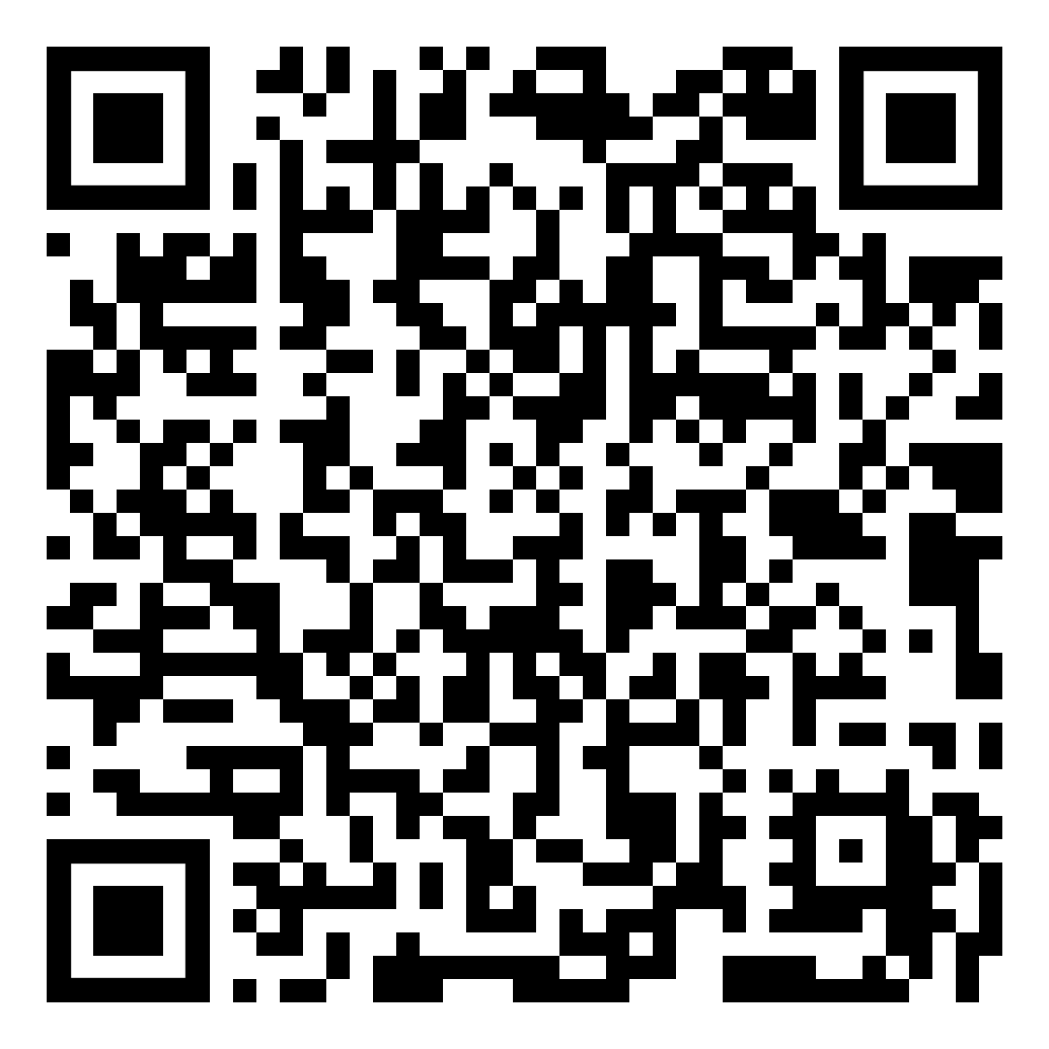
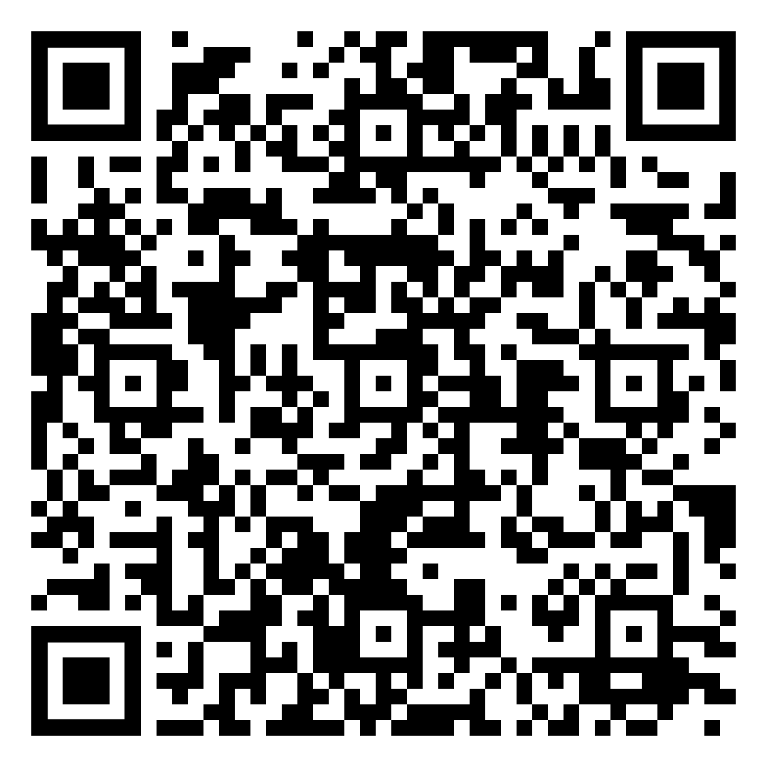
Flyers
Gilman One-Pager
Gilman-McCain One-Pager
The Benjamin A. Gilman International Scholarship Program is a program of the U.S. Department of State with funding provided by the U.S. Government and supported in its implementation by the Institute of International Education (IIE).
Notes:
You can view the Gilman digital flyers here and keep them to learn more about the Gilman Program.
If you can’t use QR codes, copy and paste the following links into your browser:
Gilman One-Pager: https://www.gilmanscholarship.org/wp-content/uploads/2023/03/Gilman_TwoPager_March-2023-.pdf
Gilman-McCain One-Pager: https://www.gilmanscholarship.org/wp-content/uploads/2022/12/GilmanMcCain_OnePager_no-dates_December-2022.pdf

Slide 35
Gilman Contact Information
Gilman@iie.org
800.852.2141 Ext. 1
Gilmanscholarship.org
The Benjamin A. Gilman International Scholarship Program is a program of the U.S. Department of State with funding provided by the U.S. Government and supported in its implementation by the Institute of International Education (IIE).
Notes:
If you have any questions, you can reach out to the Gilman Scholarship Program directly.

Slide 36
MCC Contact Information
Study Abroad Office
Email: studyabroad@mesacc.edu
Phone: 480.461.7870
Website: mesacc.edu/study-abroad
Writing Center
Email: nicole.bradley@mesacc.edu
Phone: 480.461.7678
Website: mesacc.edu/writingcenter
The Benjamin A. Gilman International Scholarship Program is a program of the U.S. Department of State with funding provided by the U.S. Government and supported in its implementation by the Institute of International Education (IIE).
Notes:
If you have any questions about study abroad or how to get writing support, please reach out to us. We’re always happy to help!

